Slide 1
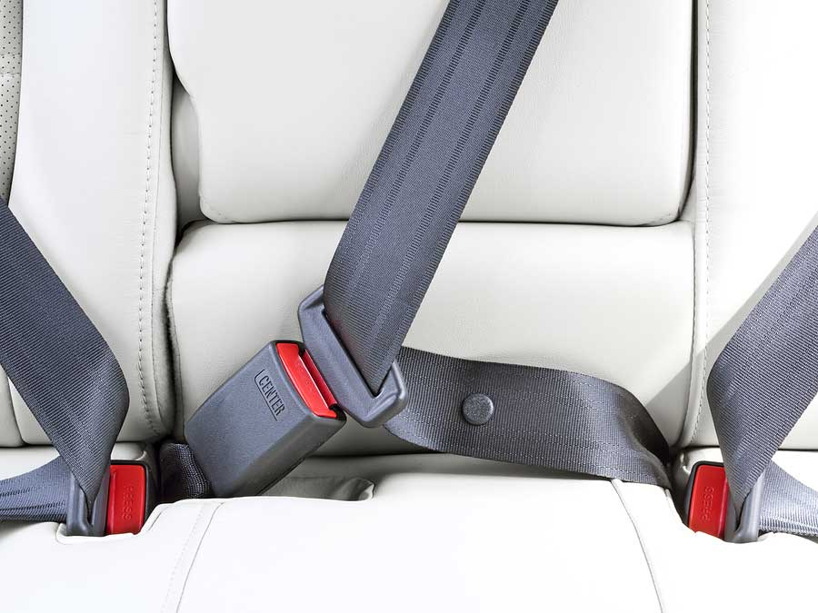
EHIPASSIKO
B2-21 2018
MPD18I003
MPD18I004
MPD18I028
MFD18I015

Slide 2

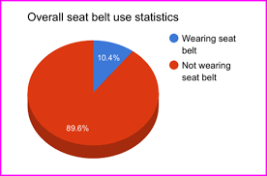
PROBLEM STATEMENT
B2-21 2018
Can you believe this? I don’t think I will drive without wearing seatbelts…
Increased number of deaths by motor vehicle accidents that was because of not wearing seatbelt, which is backed by statistical analysis.

Slide 3
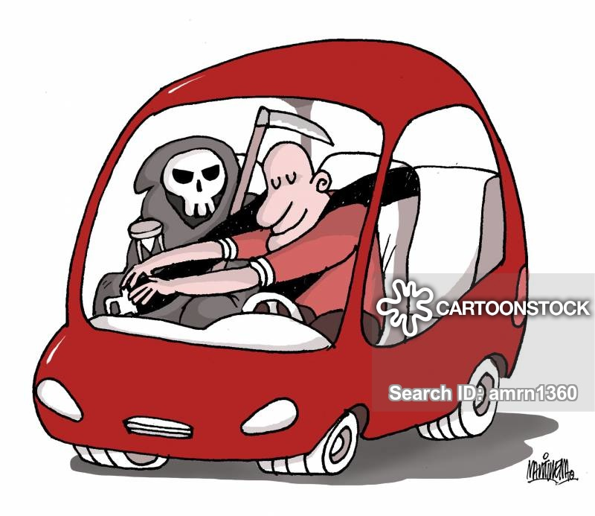
INTRODUCTION
B2-21 2018
Our group presents the topic automation in seatbelt, a simple system based on sensors, a lock (which is actuated with the help of sensors.) and control system. This does not allow the user to drive the vehicle without wearing the seatbelt.
This is a new approach that we are trying to implement because we give importance to safety over business. Even then, we try to maximize our profits so as to survive in the market.
PRODUCT: -Automation in Seatbelt
INDUSTRY: - Manufacture of parts and services of bodies for motor vehicles such as safety belts, airbags, doors, bumpers.
NIC CODE: -29302

Slide 4
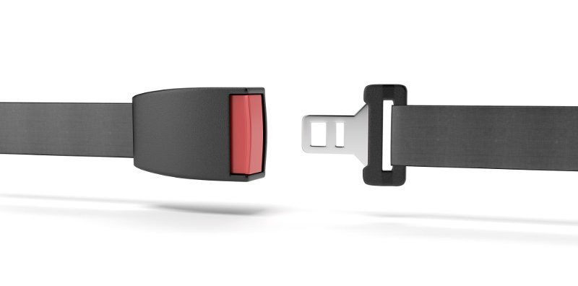
WHAT DO WE ACHIEVE FROM DOING SO?
B2-21 2018
This is a new approach which we try to implement to give importance to safety over business.
It is profitable as we only use sensors in addition to the conventional seatbelt model.
We can get the materials manufactured in other factories, which leads to reduction in manufacturing costs.
This can also be used in upcoming vehicles that can be sold at higher prices to increase both safety and profits.

Slide 5
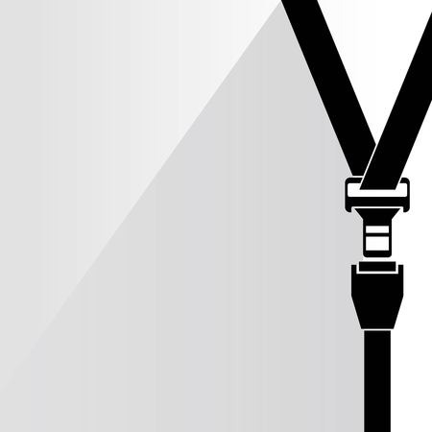

KEY PLAYERS
B2-21 2018
customers | Car companies like: Fiat(Italian): private Toyota (Japan)
supplier | Shivam narrow fabrics Fibre2Fashion Technical textile Urjita electronics pvt.ltd
Competitors: | Lear Corporation General Motors Bosch Ltd Magna International Inc. Valeo
Academic Institution/ Industry Bodies | SAE International, National Automotive Dealers Association (NADA) , Global Automakers
Investors/Financial Analysts | Hind Motors Force Motors SML Isuzu

Slide 6
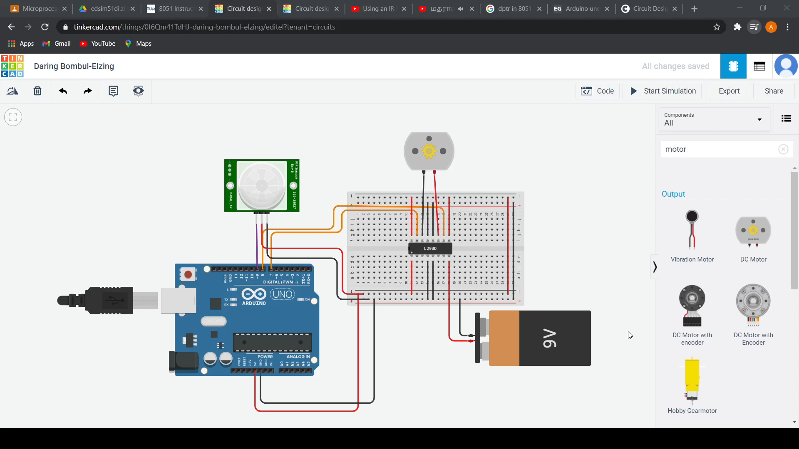

B2-21 2018

Slide 7
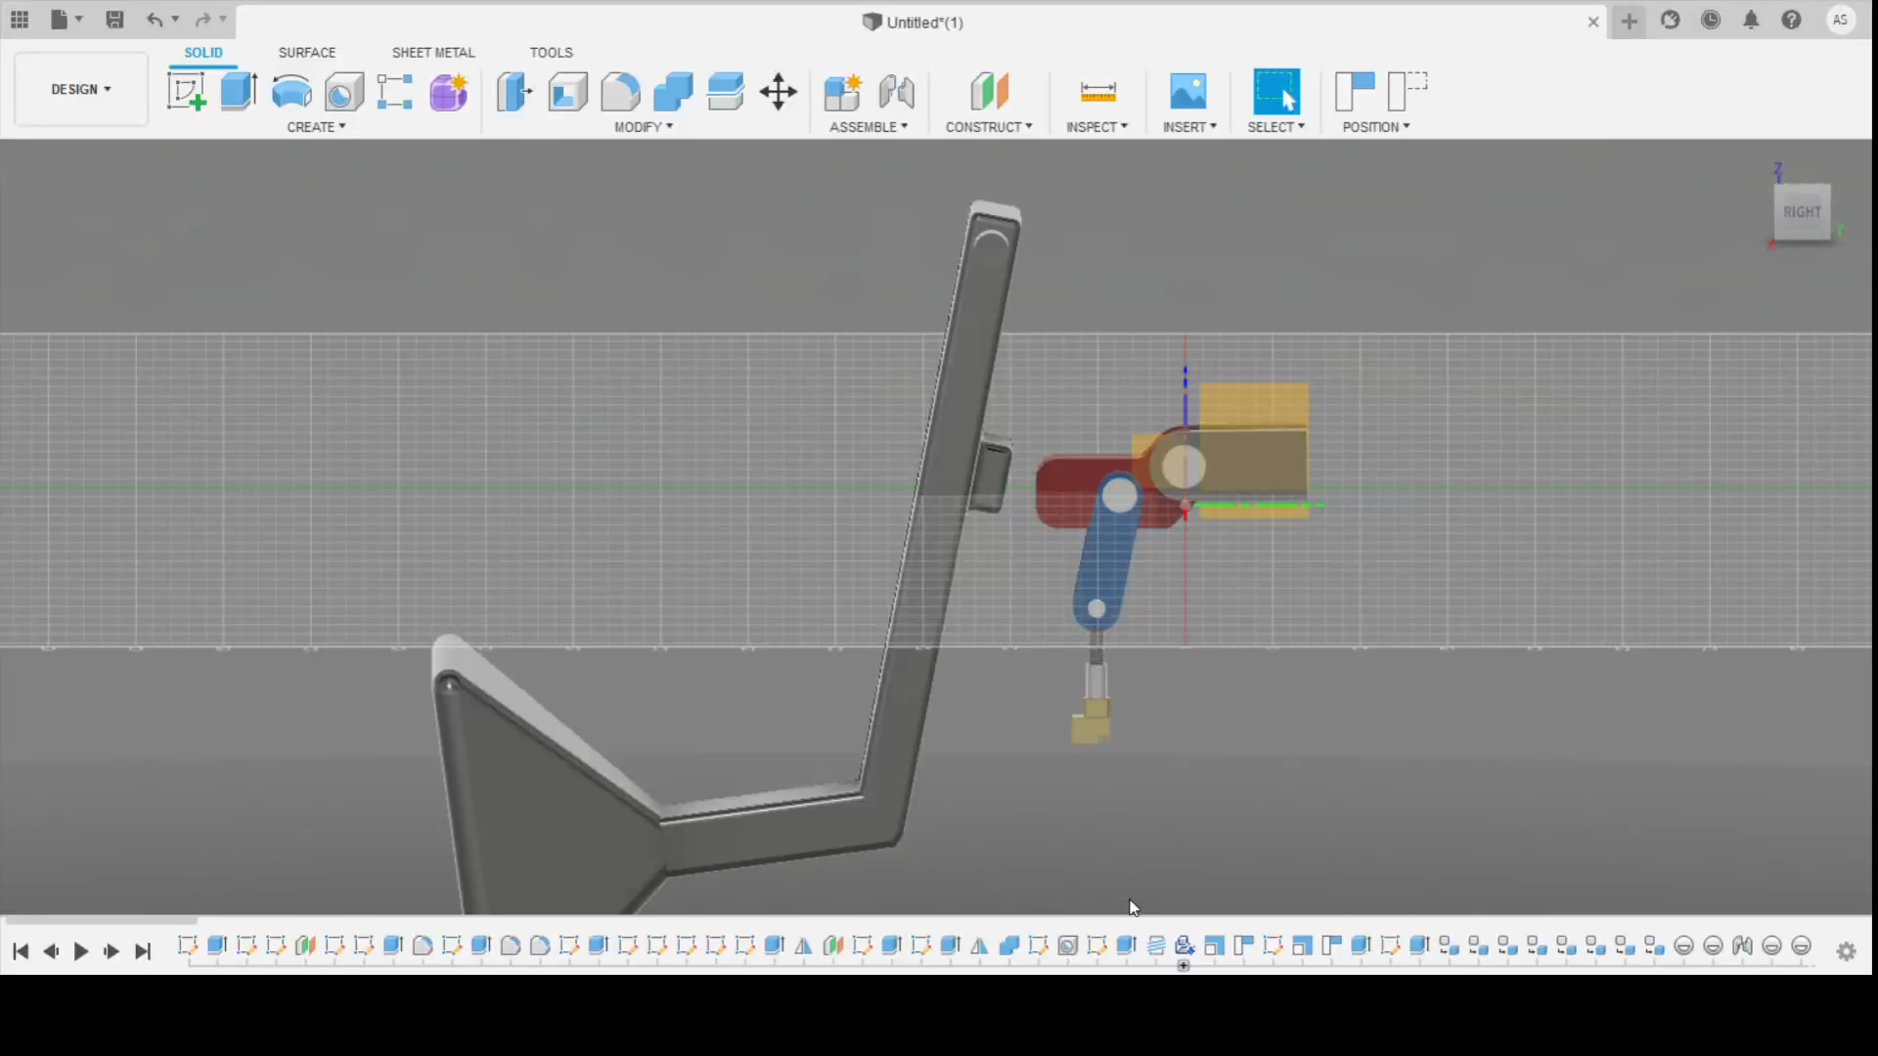
B2-21 2018

Slide 8
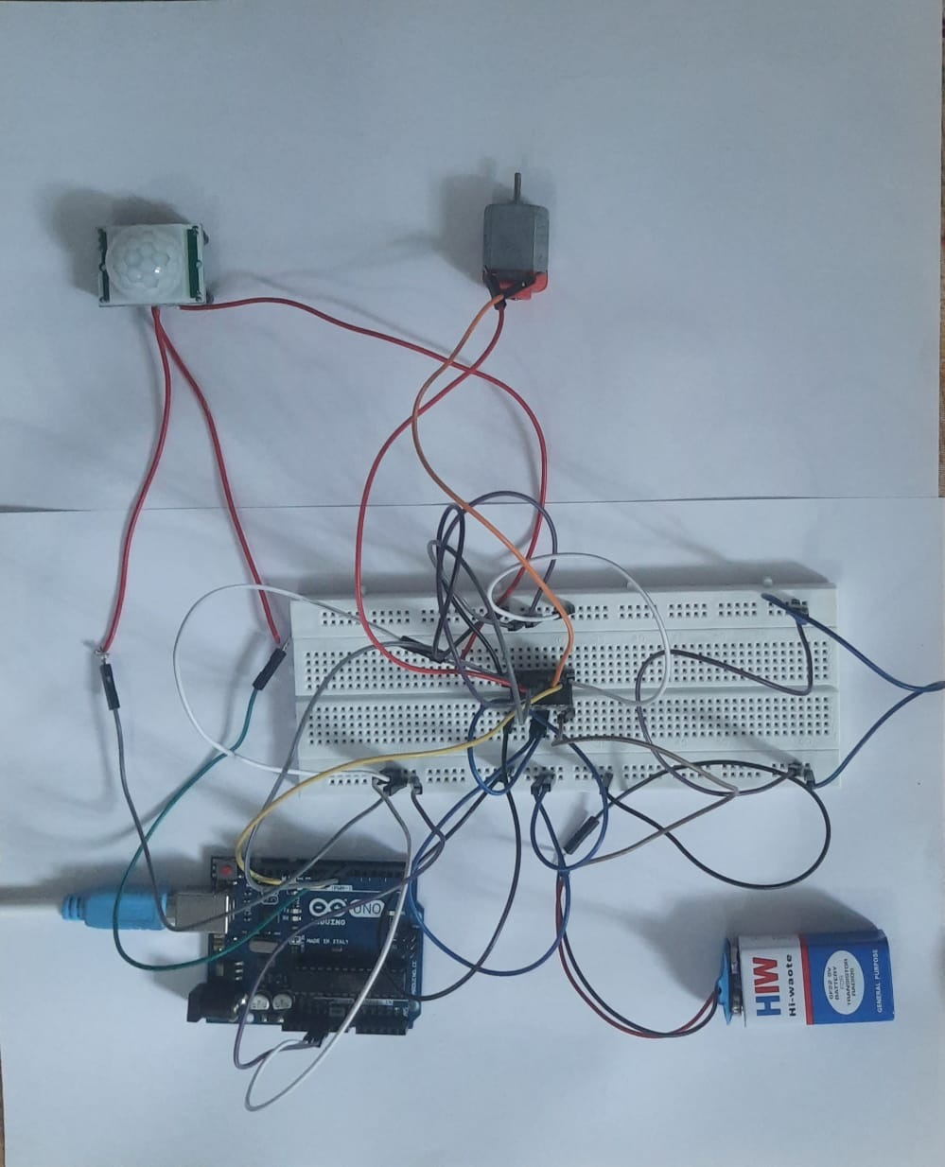
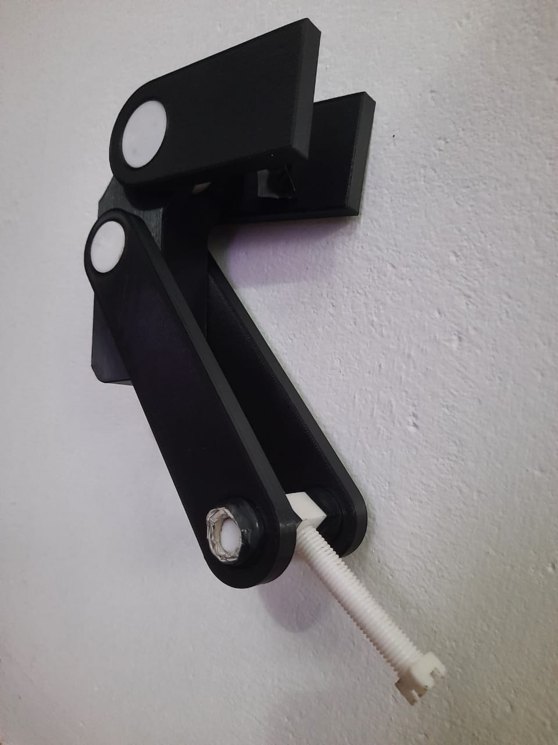

Slide 9
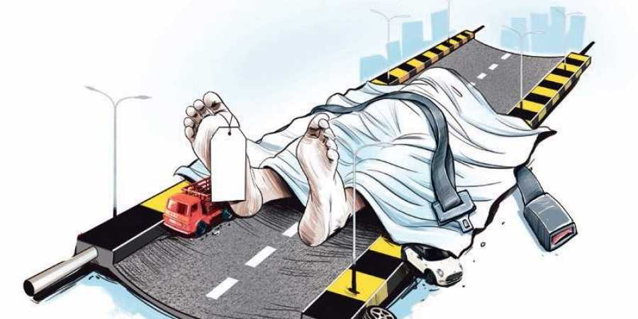
CONCLUSION
B2-21 2018
We have decided to manufacture the seatbelt as it looks profitable and regards safety above all. However, the idea needs time to be implemented as it’s a new approach which could face criticisms and hardships in the market. But the market looks promising, hence it might work out.

